Slide 1
INTELLIGENT ADMISSIONS:
R.V. GOVERNMENT ARTS COLLEGE,
CHENGALPATTU – 603 001.
BACHELOR OF COMPUTER APPLICATIONS
BY
HARISH.V
CHITHRA.V
TAMIZHSELVI.V
KATHIRAVAN.I
THE FUTURE OF UNIVERSITY DECISION MAKING WITH ML….

Slide 2
INTRODUCTION
The aim of the project is to help students in short listing universities with their profiles.
By using machine learning algorithm,students can able to predict the chances of applicants being addmitted.
The predicted output gives the fair idea about the admissions in universities.

Slide 3
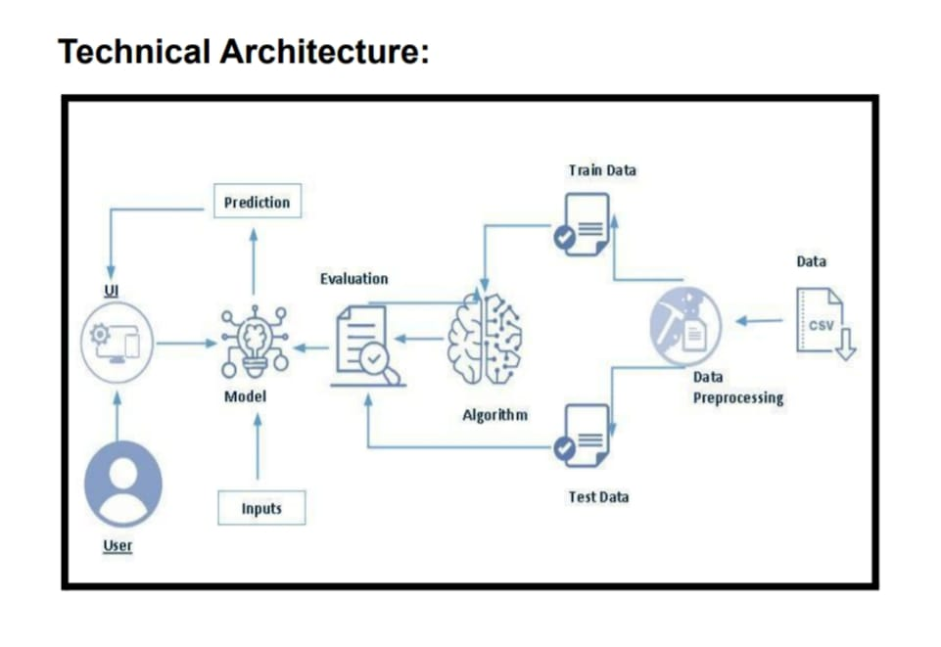

Slide 4
Major objective
Machine learning heavily depends on data.
University admission is the process which takes several steps, submitting of application,taking enterance exam etc.
To avoid the confusions and conflits of the students ML,used various algorithm to predict the future admission process.
Reducing of waiting time.
Students are well informed about their admissions.

Slide 5
Project flow
User interacts with the UI to enter the input.
Entered input is analysed by the model which is integrated.
Once the model analyses the input the prediction is showcase on the UI.
To accomplish this we have to follow the methodologies.

Slide 6
Methodolgies
PROBLEM UNDERSTANDING
Initially first we have to spend some time on what are the problems.
And go through on the problem that, students facing during their pre-admission period, and we should set the solutions to those problems.

Slide 7
Data collection &preparation
Data should be collectd from different sources.
There are many popular open sources for collecting the data.EG. Kaggle.com,UCI repository,etc.
The downloaded dataset is not suitable for training, so we need to clean it properly to fetch the good results.

Slide 8
DATA ANALYSIS
DESCRIPTIVE ANALYSIS:
Its an study of the basic features of data with the stastical process.
Visual analysis:
Visual analysis is the proces of using visual representation like chats ,plots and graphs to explore and understand data.DESCRIPTIVE ANAYSIS

Slide 9
Model building:
There are several ML,models have to be developed using various machine learning algorithms for admissions to a particular universities for this we applied four classification algorithm.
Performance testing:
By testing the process it can provide a understandings of model’s strenght and weakness.

Slide 10
Conclusion
The main goal of this work is to create a machine learning model which could be used by students who wan to puruse their education in abroad.
Many machine learning algorithm are used for this research.
Students can use the model to assess the chance of getting admission in particular university.

